Slide 1
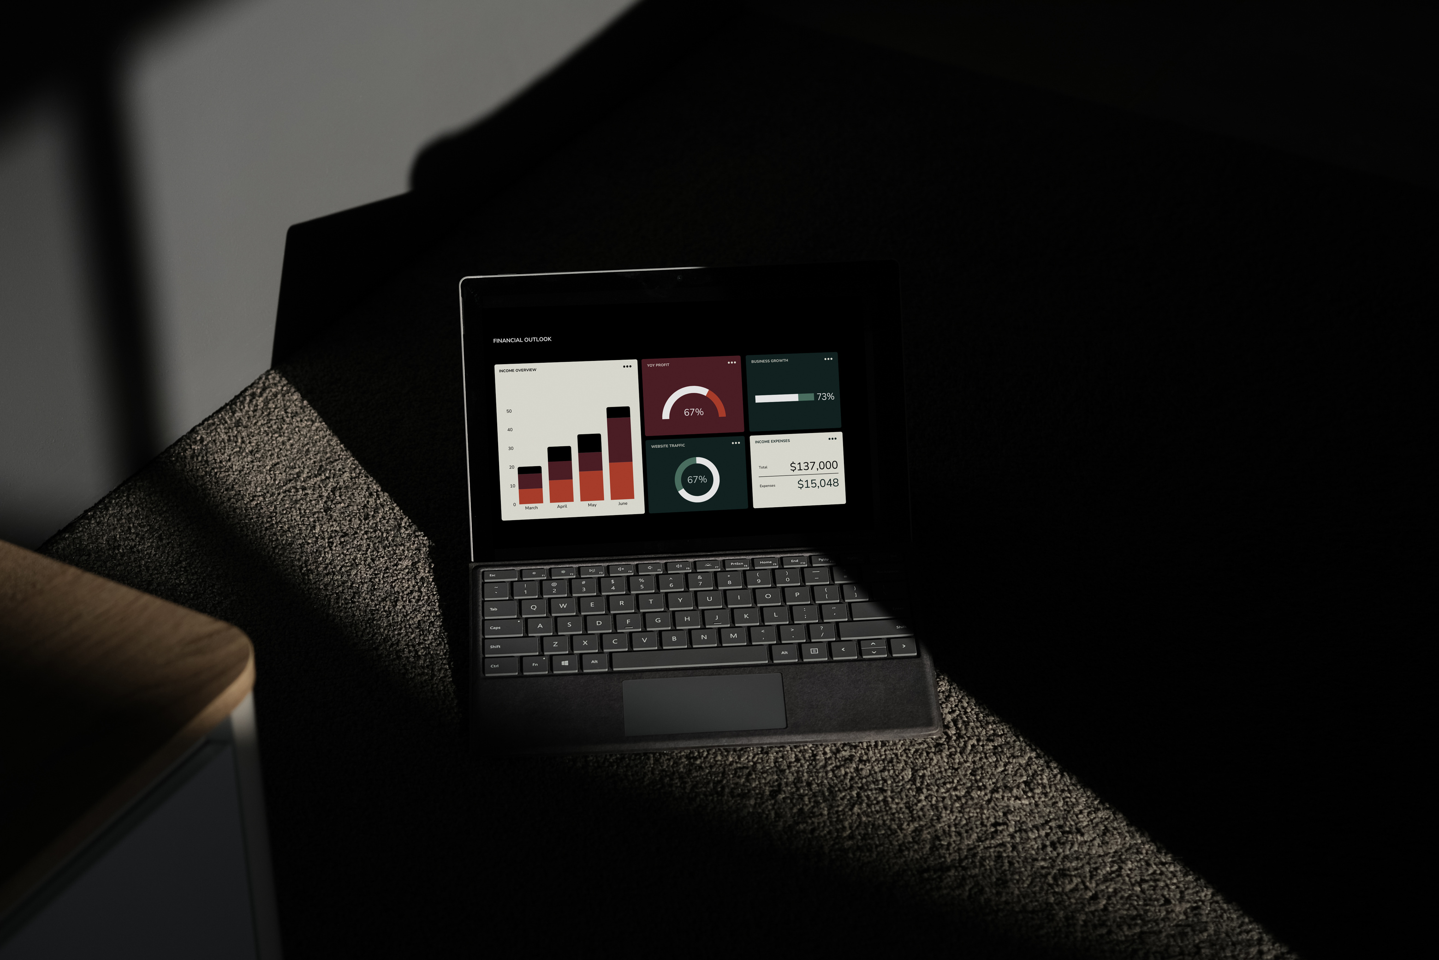
Data Analystics - Case Study (Superstore)

Slide 2

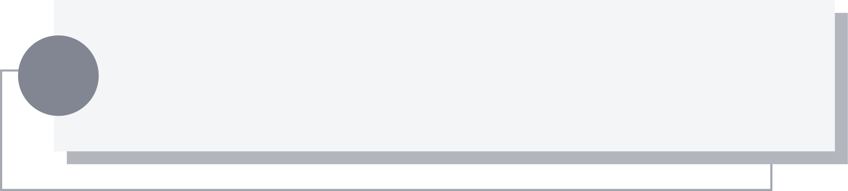
Methodology
Top-Down Analysis
Step 1
Step 4
Understanding the business process
Understand the sales process flow in the Superstore Sales dataset, from order placement to sales performance evaluation.
Identify Business Problems
Identify business challenges based on analysis results.
Step 2
Step 5
Identify KPI Metrics
Determine key performance indicators (KPIs) to analyze sales performance and customer retention.
Solutions & Recommendations
Provide strategic solutions and recommendations based on the analysis findings.
Step 3
KPI
Reviewing the Data at a High-Level Overview
Sales Trends: Total sales over time.
Regional Sales: Sales performance by region and segment.
Customer Retention: Rate of returning customers.
Quarterly Sales Patterns: Identify quarters with the highest and lowest performance.
Segment Performance: Evaluate segment performance in each quarter.
Conduct a comprehensive data analysis to identify significant patterns and trends.

Slide 3



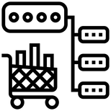

Overview
Total Sales: $2.252.607
Metrics:
Sales by Region:
West -> $710.219,68
Sales: Total sales.
Sales by Region: The region with the highest sales.
Sales by Segment: The highest sales by customer segment.
Sales by Category: Category with the highest sales.
Sales by Segment:
Consumer -> $1.146.708
Sales by Category: Technology -> $825.856

Slide 4
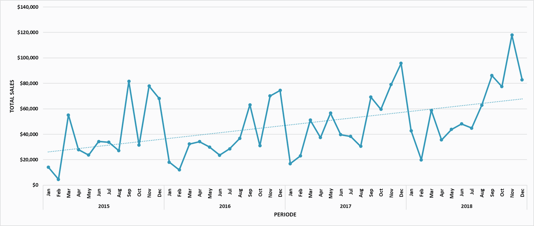

Sales Trends
Several points on the graph indicate significant fluctuations, while the dashed trend line demonstrates a year-over-year increase in total sales.
Sales tend to increase during the period from September to December each year, likely associated with the holiday season or peak business activity.
A sharp decline in sales consistently occurs at the beginning of the year, as observed in January 2016, 2017, and 2018. This may be due to the post-holiday period when purchasing activity decreases.

Slide 5
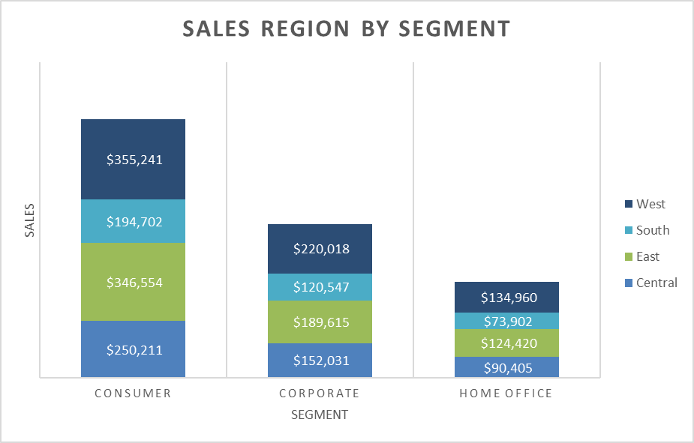

Sales Region by Segment
The consumer segment makes the largest contribution to revenue across all regions, making it the primary target for sales strategies. The consumer segment contributes 51% to the total sales of the Superstore.

Slide 6
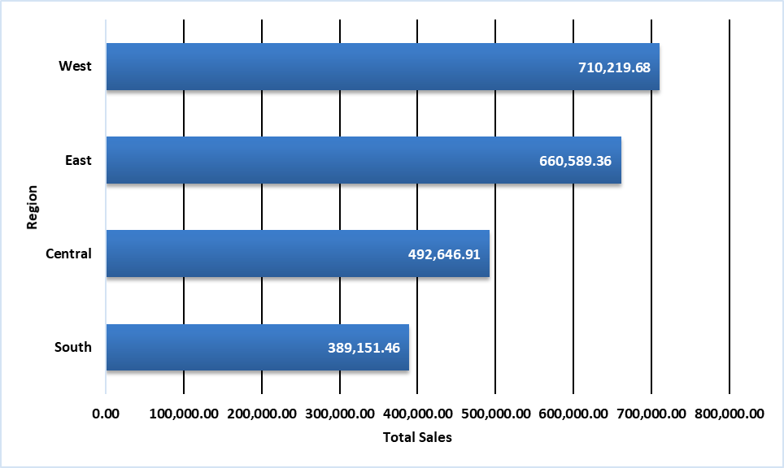
Sale by Region
The West and East regions exhibit relatively higher sales levels compared to the other two regions, Central and South. This suggests that customers in the West and East regions may have different characteristics or preferences compared to those in the Central and South regions.

Slide 7
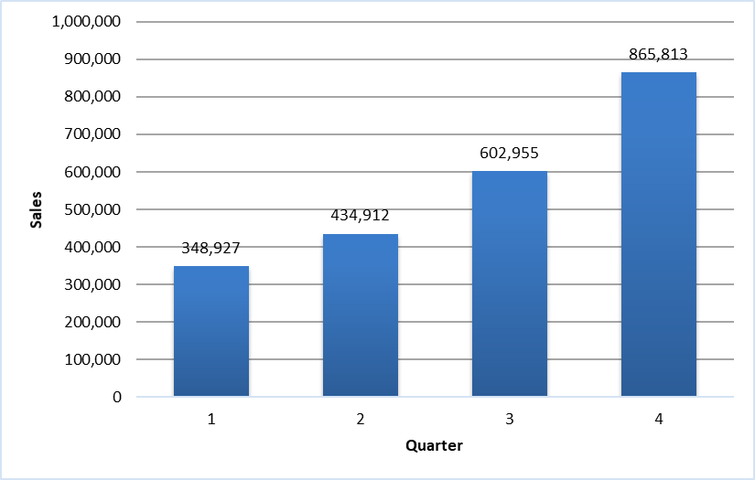
Sales by Quarter
There is a positive trend in the increase of total revenue from quarter to quarter, with the most significant growth occurring in the fourth quarter. This phenomenon is likely influenced by seasonal factors, such as Thanksgiving celebrations and preparations for Christmas and New Year.

Slide 8


Business Questions
What is the comparison between customers who make repeat transactions and those who no longer make transactions?
Is the difference in total sales between the West-East regions and the Central-South regions influenced by variations in customer retention rates?
What is the contribution of customers in each segment by quarter?

Slide 9
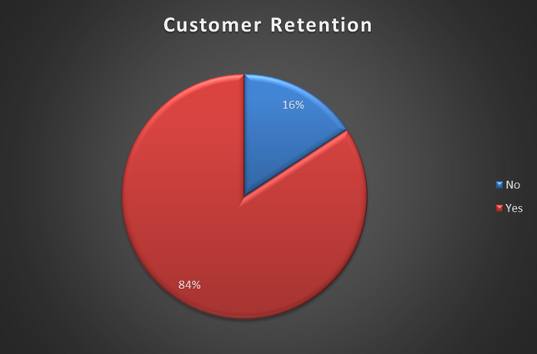
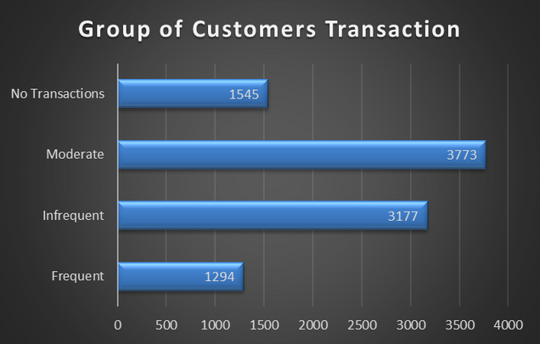
Customer Retention Rate Comparison
Customer retention rate is very high, with approximately 84% of customers returning for transactions and 16% not returning.
However, when segmentation is applied, the number of customers who shop regularly is still much lower, at around 13%. The majority of customers fall into the Infrequent and Moderate groups, with respective percentages of 32% and 39%, while the remaining 16% have not returned for further transactions.

Slide 10
Comparison of Customer Retention Rates
The difference in total sales between regions is influenced by customer income or purchasing power. The West and East regions, with higher total sales, likely have customers with greater purchasing power compared to Central and South. Although the Frequent group is smaller, income plays a role in this disparity.
The difference in total sales between regions is influenced by customer purchasing power. The West and East regions, with higher total sales, likely have customers with greater purchasing power compared to Central and South. Although the Frequent group is smaller, income plays a role in this disparity.
Number of Customer Group | Number of Customer Group | Number of Customer Group | Number of Customer Group | Number of Customer Group
Region | Frequent | Infrequent | Moderate | No Transactions
Central | 309 | 743 | 889 | 336
East | 412 | 821 | 1064 | 477
South | 174 | 564 | 602 | 258
West | 399 | 1049 | 1218 | 474

Slide 11
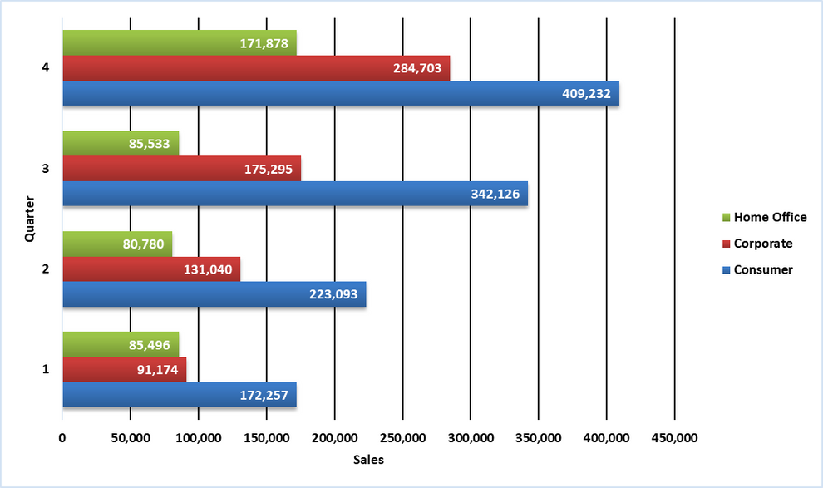
Sales Performance Per Segment by Quarter
The consumer segment has consistently shown strong growth quarter over quarter, indicating a stable increase in demand for products sold to individual consumers.
The corporate segment has exhibited significant fluctuations in sales. There was a revenue increase in the third quarter, followed by a sharp rise in the fourth quarter.

Slide 12

Recommendations
Implement personalized promotions for customers in the infrequent and moderate groups, such as discount offers or special promotions. For customers who make regular transactions, a cashback program or exclusive offers can be applied for high-value transactions.
Conduct a thorough analysis of revenue by region to identify specific market segments. Additionally, personalized offers can be made based on the customers's purchase history.
Perform a competitor performance analysis to assess the company's position and identify opportunities for market share growth.

